Slide 1
Exploring Semantic Segmentation: Dataset, Techniques, and Challenges
Mehadi Hasan
Reg. no.: 46341
Session: 2021-2022
Dr. Mohammad Shorif Uddin
Professor
Department of CSE
Sunday, 15 September, 2024

Slide 2
Slide Outline
Introduction
Objective
Basic Terminology
Popular Deep Network Architectures
Datasets
Challenges
Future Opportunities
Conclusion

Slide 3
Introduction
The main objective of this research is to conduct a detailed examination of semantic segmentation, with a focus on:
Investigating deep learning architectures and methodologies utilized for semantic segmentation.
Systematically reviewing and comparing prominent datasets used for training and evaluating segmentation models.
Assessing current challenges in the domain, and proposing potential avenues for future research and advancements.

Slide 4
Objective
The objective of this research is to comprehensively explore semantic segmentation by analyzing cutting-edge deep learning techniques, evaluating widely-used datasets, and identifying key challenges and opportunities for advancement in the field.

Slide 5
Basic Terminology
What is an image?
An image is defined as a two-dimensional function F(x, y) where x and y are spatial coordinates, and the amplitude of F at any pair of coordinates (x, y) is called the intensity of that image at that point. When x, y and amplitude values of F are finite, we call it a digital image.

Slide 6
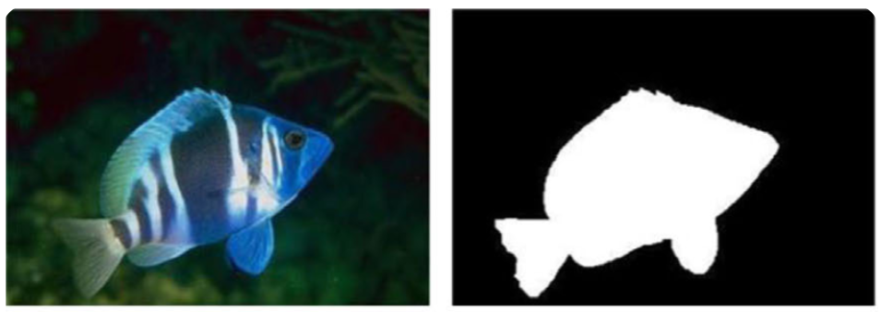
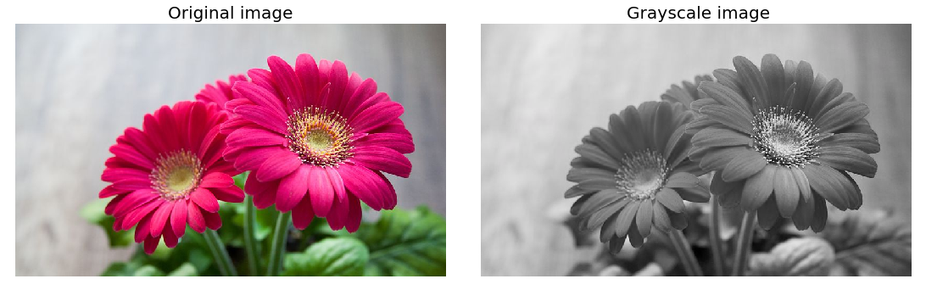
Basic Terminology (cont.)
Types of image
Binary Image Images that have only two unique values of pixel intensity- 0 (representing black) and 1 (representing white) are called binary images. | Grayscale Image Grayscale or 8-bit images are composed of 256 unique colors, where a pixel intensity of 0 represents the black color and pixel intensity of 255 represents the white color.

Slide 7
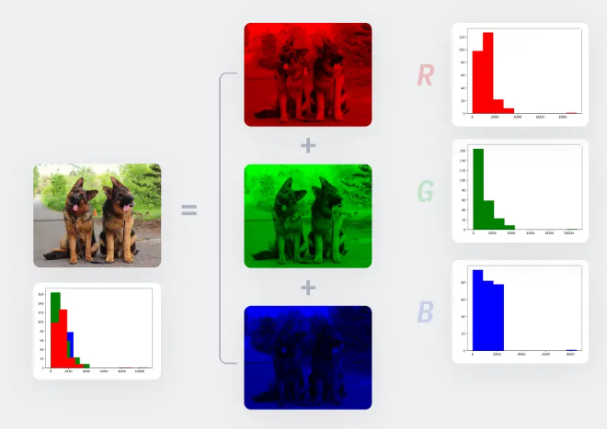
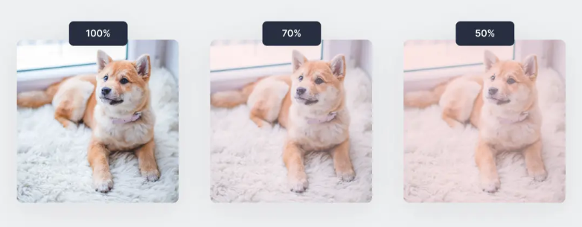
Basic Terminology (cont.)
Types of image
RGB Color Image The images we are used to in the modern world are RGB or colored images which are 16-bit matrices to computers. That is, 65,536 different colors are possible for each pixel. “RGB” represents the Red, Green, and Blue “channels” of an image. | RGBA Image RGBA images are colored RGB images with an extra channel known as “alpha” that depicts the opacity of the RGB image. Opacity ranges from a value of 0% to 100% and is essentially a “see-through” property.

Slide 8
Basic Terminology (cont.)
Digital Image Processing
Digital image processing is the use of algorithms and mathematical models to process and analyze digital images. The goal of digital image processing is to enhance the quality of images, extract meaningful information from images, and automate image-based tasks.

Slide 9
Basic Terminology (cont.)
Image Processing Techniques
Image Enhancement
Image Restoration
Image Segmentation
Object Detection
Image Compression
Image Manipulation
Image Generation
Image-to-Image Translation

Slide 10
Basic Terminology (cont.)
Image Segmentation
Image segmentation is a fundamental technique in digital image processing and computer vision. It involves partitioning a digital image into multiple segments (regions or objects) to simplify and analyze an image by separating it into meaningful components, which makes the image processing more efficient by focusing on specific regions of interest.
Segmentation Techniques
Semantic segmentation
Instance segmentation
Panoptic segmentation

Slide 11
Semantic segmentation
Semantic segmentation
Semantic segmentation is a process in computer vision where each pixel in an image is assigned a specific class label. The goal is to divide an image into meaningful regions by classifying each pixel into categories such as "sky," "car," "tree," etc.
Semantic segmentation involves:
Pixel-wise Classification: Each pixel in the image is labeled based on its class.
Scene Understanding: It helps in breaking down complex scenes into distinct objects or regions.

Slide 12
Applications of Semantic segmentation
Autonomous Vehicles
  Road Scene Understanding
  Traffic Signal Detection
Medical Imaging
  Tumor Detection
  Organ Segmentation
Agriculture
  Plant Disease Detection
  Crop Counting
Satellite and Aerial Imagery
  Land Use Classification
  Disaster Management
Robotics
  Object Recognition
  Grasping and Manipulation

Slide 13
Applications of Semantic segmentation
Augmented Reality (AR)
  Real-Time Object Identification
  Background Removal
Security and Surveillance
  Anomaly Detection
  Facial Recognition and Tracking
Fashion and Retail
  Clothing Segmentation
  Inventory Monitoring
Smart Cities
  Urban Planning
  Traffic Monitoring
Image Editing and Enhancement
  Background Removal and Editing
  Photo and Video Enhancement

Slide 14
Deep Learning Architecture
Popular Deep Learning Architecture for Semantic Segmentation:
    AlexNet
    MCG
    VGG-16
    ResNet
    GoogLeNet

Slide 15
Deep Learning Architecture (cont.)
AlexNet:
AlexNet is a pioneering deep learning architecture developed by Alex Krizhevsky et al. in 2012. It was primarily designed for image classification tasks and won the ImageNet Large Scale Visual Recognition Challenge (ILSVRC) in 2012.
Architecture Overview:
Layers: 5 convolutional layers followed by 3 fully connected layers.
Activation: ReLU non-linearity after each convolutional and fully connected layer.
Pooling: Max pooling layers to reduce spatial dimensions and computations.
Dropout: Included to reduce overfitting in fully connected layers.
Normalization: Local Response Normalization (LRN) after ReLU in some layers to mimic lateral inhibition in the brain.

Slide 16
Deep Learning Architecture (cont.)
Pros of AlexNet:
Effective Feature Extraction
Relatively Simple Architecture
Improved Performance
Pioneered Deep Learning
Cons of AlexNet:
Large Parameter Count
Overfitting on Small Datasets
High Computational Cost
Lower Accuracy

Slide 17
Deep Learning Architecture (cont.)
MCG:
MCG (Multiscale Combinatorial Grouping) is a region proposal generation method used in computer vision tasks like object detection and semantic segmentation. It generates candidate object regions in an image by combining multiple hierarchical image segmentations at various scales.
Key Features of MCG:
Multiscale Approach
Combinatorial Grouping
Accurate Object Proposals
Efficient Candidate Region Generation

Slide 18
Deep Learning Architecture (cont.)
Pros of MCG:
Multiscale Representation
Effective for Object Detection
Improves Segmentation Models
Flexible Use
Cons of MCG:
Computationally Intensive
Not Real-Time
Complex Implementation

Slide 19
Deep Learning Architecture (cont.)
VGG-16:
VGG-16 is a popular deep learning architecture primarily used for image classification, but it can also be adapted for tasks like semantic segmentation. Developed by the Visual Geometry Group (VGG) at Oxford, VGG-16 became famous for its simplicity and depth, making it one of the foundational architectures in the deep learning community.

Slide 20
Deep Learning Architecture (cont.)
Pros of VGG-16:
High Performance
Transfer Learning
Generalization Capability
Effective for Object Recognition
Cons of VGG-16:
High Memory Requirements
Expensive Training
Overfitting
Difficulty in Real-Time Applications

Slide 21
Deep Learning Architecture (cont.)
ResNet:
ResNet (Residual Network) is one of the most influential architectures in deep learning, particularly in the realm of image recognition and semantic segmentation. Developed by Microsoft Research and introduced in 2015
ResNet Architecture:
ResNet comes in various depths, with ResNet-50, ResNet-101, and ResNet-152 being the most common.
The basic building block of ResNet is a residual block, which contains a set of convolutional layers, followed by a skip connection.
ResNet-50, for example, has 50 layers, including convolutional, pooling, and fully connected layers.
Batch normalization is used after each convolution.

Slide 22
Deep Learning Architecture (cont.)
Pros of ResNet:
Ease of Training
Strong Generalization
Improved Accuracy
Ease of Training
Cons of ResNet:
High Memory Usage
Increased Complexity
Performance Decreases with Depth (After a Point)
Overfitting

Slide 23
Deep Learning Architecture (cont.)
GoogleNet:
GoogleNet, also known as Inception, is a deep convolutional neural network developed by Google that won the ILSVRC 2014 (ImageNet Large Scale Visual Recognition Challenge). The architecture is unique due to its use of Inception modules, which allow for more efficient computation by using different-sized filters within the same layer.
GoogleNet Architecture:
Deep network with 22 layers.
Inception Modules
Global Average Pooling (GAP)
Fewer Parameters

Slide 24
Deep Learning Architecture (cont.)
Pros of GoogleNet:
Fewer Parameters
Multi-scale Feature Extraction
Good for Transfer Learning
Efficient Computation
Cons of GoogleNet:
Complex Architecture
Difficult to Tune
Inflexible for Real-Time Applications
Requires Careful Design

Slide 25
Datasets
Name | Purpose | Year | Classes | Data | Resolution | Sequence | Synthetic/Real | Samples (Training) | Samples (Validation) | Samples (Test)
PASCAL VOC 2012 | Segmentation | 2012 | 21 | 2D | Variable | ✗ | R | 1464 | 1449 | Private
PASCAL-Context | Generic | 2014 | 540 (59) | 2D | Variable | ✗ | R | 10103 | N/A | 9637
PASCAL-Part | Generic-Part | 2014 | 20 | 2D | Variable | ✗ | R | 10103 | N/A | 9637
SBD | Generic | 2011 | 21 | 2D | Variable | ✗ | R | 8498 | 2857 | N/A
Microsoft COCO | Generic | 2014 | 80 | 2D | Variable | ✗ | R | 82783 | 40504 | 81434
SYNTHIA | Urban (Driving) | 2016 | 11 | 2D | 960 × 720 | ✗ | S | 13407 | N/A | N/A
Cityscapes (fine) | Urban | 2015 | 30 (8) | 2D | 2048 × 1024 | ✓ | R | 2975 | 500 | 1525
Cityscapes (coarse) | Urban | 2015 | 30 (8) | 2D | 2048 × 1024 | ✓ | R | 22973 | 500 | N/A
CamVid | Urban (Driving) | 2009 | 32 | 2D | 960 × 720 | ✓ | R | 701 | N/A | N/A
KITTI-Layout | Urban/Driving | 2012 | 3 | 2D | Variable | ✗ | R | 323 | N/A | N/A
KITTI-Ros | Urban/Driving | 2015 | 11 | 2D | Variable | ✗ | R | 170 | N/A | 46
KITTI-Zhang | Urban/Driving | 2015 | 10 | 2D/3D | 1226 × 370 | ✗ | R | 140 | N/A | 112
Stanford background | Outdoor | 2009 | 8 | 2D | 320 × 240 | ✗ | R | 725 | N/A | N/A
SiftFlow | Outdoor | 2011 | 33 | 2D | 256 × 256 | ✗ | R | 2688 | N/A | N/A
Youtube-Objects-Jain | Objects | 2014 | 10 | 2D | 480 × 360 | ✓ | R | 10167 | N/A | N/A
Adobe’s Portrait Segmentation | Portrait | 2016 | 2 | 2D | 600 × 800 | ✗ | R | 1500 | 300 | N/A
MINC | Materials | 2015 | 23 | 2D | Variable | ✗ | R | 7061 | 2500 | 5000
DAVIS | Generic | 2016 | 4 | 2D | 480p | ✓ | R | 4219 | 2023 | 2180
NYUDv2 | Indoor | 2012 | 40 | 2.5D | 480 × 640 | ✗ | R | 795 | 654 | N/A
SUN3D | Indoor | 2013 | – | 2.5D | 640 × 480 | ✓ | R | 19640 | N/A | N/A
SUNRGBD | Indoor | 2015 | 37 | 2.5D | Variable | ✗ | R | 2666 | 2619 | 5050
RGB-D Object Dataset | Household objects | 2011 | 51 | 2.5D | 640 × 480 | ✓ | R | 207920 | N/A | N/A

Slide 26
Challenges
Limited Annotated Data
Context Understanding
Real-time Inference
Challenges of Data Availability in Algorithm Training
Challenges in Assessing Algorithm Generality for General Imagery
Achieving High Accuracy with Limited Computing Resources
Contextual Challenges in Accuracy and Segmentation
Dealing with varying scales and shapes of objects
Managing overlapping objects and occlusions

Slide 27
Future Opportunities
Real-time Semantic Segmentation
Handling Varying Scales and Complex Environments
Integration with Depth and Multi-modal Data
Medical Imaging Applications
Integration with Natural Language Processing (NLP)
Edge Computing and IoT Applications
3D Semantic Segmentation
Transfer Learning and Domain Adaptation
Interactive and User-Guided Segmentation

Slide 28
Thank You

